Slide 1
A Philosophy of Information Technology
IT Pro Forum
June 6, 2014
Dave Mussulman
mussulma@illinois.edu
Engineering IT Shared Services

Slide 2
IT Pros are a practical, results driven people.
We like order, logic, efficiency, and elegance.
We get annoyed by things we don’t like.
Inefficiencies, inelegance, disorder, illogic.
Respect is the currency of the realm.
IT stereotypes devolve from not recognizing these traits.
Jeff Ello, “Opinion: The unspoken truth about managing geeks”, Computerworld, September 8, 2009

Slide 3
You don’t care about my credentials
My experience?
My degrees?
Less important than my performance.
The only time credentials matter is job interview requirements.
And not usually afterwards?

Slide 4
Associate University Librarian for Library Information Technology
“Required: Master’s degree in Computer Science, Library and Information Science, Management Information Systems or equivalent combination of education and experience”
Masters?
CS, LIS, MIS
“or equivalent education or experience”

Slide 5
Requirements for Associate Network Service Engineer
Bachelor’s degree in a computer related field or Bachelor’s degree with networking experience.
Requirements for Network Service Engineer
Bachelor’s degree required preferably in Computer Science or related area.

Slide 6
IT Specialist / Senior Specialist-Business Analyst (OBFS)
Duties:
Completes all documentation needed to capture details of processes, systems, issues and recommendations.
Conducts interviews and performs necessary research/analysis to create project requirements documentation.
Designs and evaluates interfaces utilizing user-centered design principles.
Works effectively with subject matter experts and end users to ensure user experience is formulated to achieve business goals.
Collaborates with technical teams (developers, systems analysts and database administrators) to design and implement the functional user interaction, navigation, and usability.
https://uajobs.hr.uillinois.edu/employment/job-board/details?jobID=41137&job=it-specialist-sr-specialist-business-analyst

Slide 7
IT Specialist / Senior Specialist-Business Analyst (OBFS)
Qualifications:
Candidates must possess a Bachelor’s degree in Business, Human Computer Interaction, or a related field and must possess two years’ work experience in the delivery of software solutions to be eligible for the specialist level or four years' work experience in the delivery of software solutions, two years’ work experience as a business analyst and one year experience with user experience design to be eligible for the senior specialist level.
https://uajobs.hr.uillinois.edu/employment/job-board/details?jobID=41137&job=it-specialist-sr-specialist-business-analyst

Slide 8
Director of Technology, Illinois Public Media
Candidates must have a bachelor’s degree in electrical engineering, broadcast engineering, information technology, computer networking, computer engineering or a related technology field.
Other required qualifications include:
Five years of relevant experience, three years of which must be in broadcast technology management and supervision.
Extensive broadcast engineering and IT management experience with well-developed interpersonal skills and management abilities.
Direct experience with virtualization, Microsoft endpoint and server architectures, Linux server architecture, UNIX systems and networking expertise.

Slide 9
Computer Science, by Wikipedia
Computer Science (abbreviated CS or CompSci) is the scientific and practical approach to computation and its applications. It is the systematic study of the feasibility, structure, expression, and mechanization of the methodical processes (or algorithms) that underlie the acquisition, representation, processing, storage, communication of, and access to information, whether such information is encoded as bits in a computer memory or transcribed in genes and protein structures in a human cell.^{[1]}
A computer scientist specializes in the theory of computation and the design of computational systems.^{[2]}

Slide 10
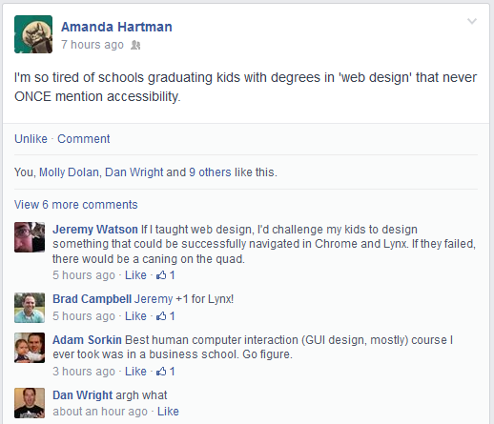
Lies, damn lies, and the things mentioned in an IT job ad
What assumptions are you making in what a degree teaches potential candidates?
Who are you excluding?
https://www.facebook.com/arhartman

Slide 11
What degrees are working in IT?
How many Computer Scientists?
How many IT, IS, CIS, MIS, ‘web design’ degrees?
How many Library and Info Science?
How many humanities degrees?
How many scientists?
How many artists?

Slide 12
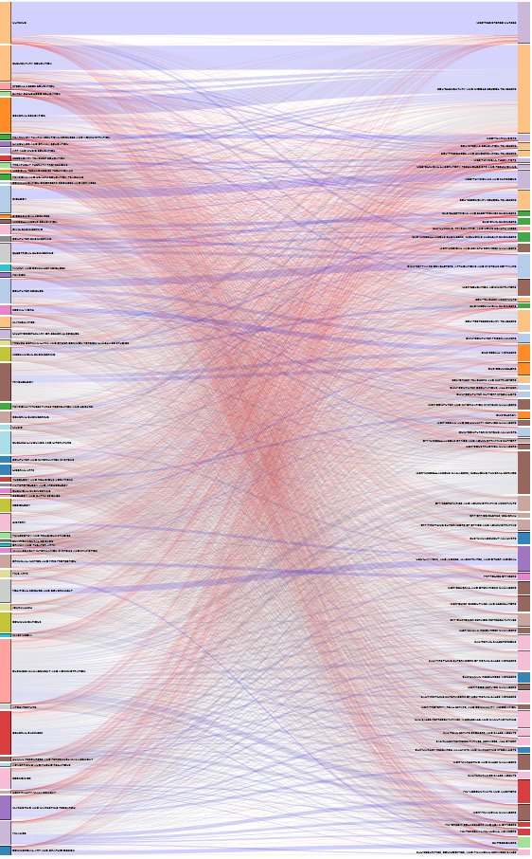
What degrees are working in IT?
http://benschmidt.org/jobs/
Majors on the left
Industries on the right

Slide 13
“Show me a computer expert who gives a damn, and I'll show you a librarian.”
- Patricia Wilson Berger, former president, American Library Association
http://www.lis.Illinois.edu/future-students

Slide 15
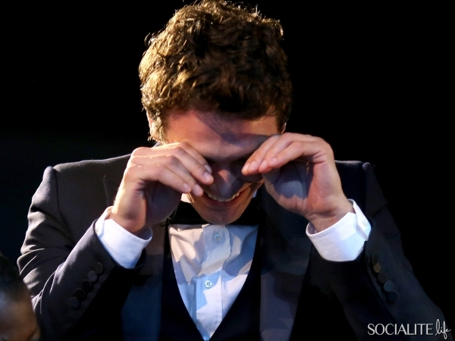
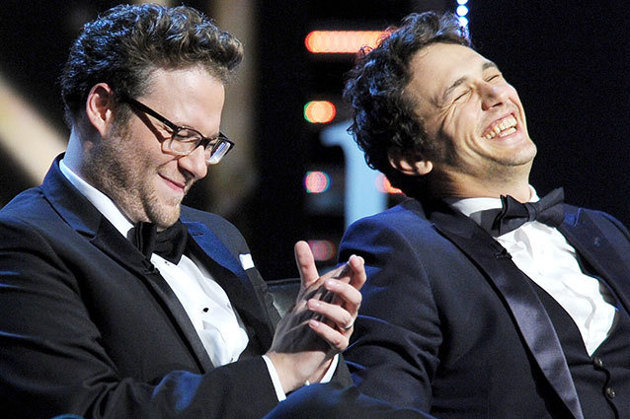
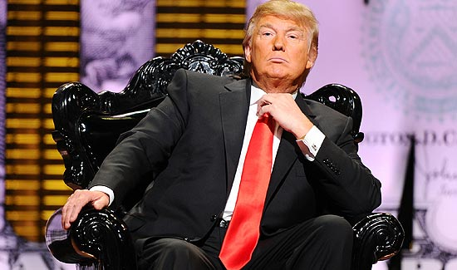
This kind of roast

Slide 16
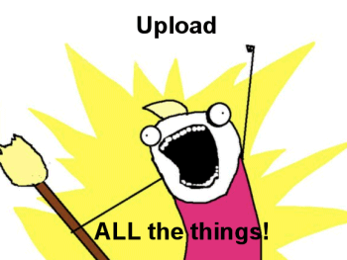
http://googlesystem.blogspot.com/2011/07/google-docs-lets-you-upload-10gb-files.html
http://www.flickr.com/photos/infilta/209094032/

Slide 17
Leave you with something to:
look out for? consider?
change?

Slide 18
For the job descriptions:
Don’t make assumptions about what degrees can do which jobs.
List the desired duties, and figure out how to evaluate if the candidate has them.

Slide 19
IT Specialists: Associate, Specialist, and Senior Levels - Engineering IT
Associate
Bachelor’s Degree
1 year full-time or equivalent part-time professional experience in IT operations which must include:
1 year experience supporting Windows, Mac, or Linux workstations.
Experience working in a customer service environment.
Specialist
Bachelor’s Degree
3 years full-time or equivalent…
Senior
Bachelor’s Degree
6 years full-time or equivalent…
https://jobs.illinois.edu/academic-job-board/job-details?jobID=40430&job=it-specialists-associate-specialist-and-senior-levels-engineering-it-shared-services-a1400174

Slide 20
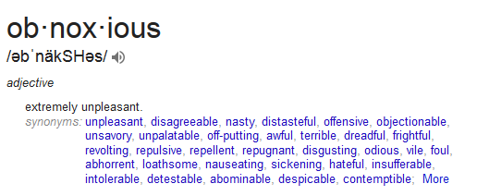
IT professionals
are obnoxious.
IT professionals are very detail-oriented.
IT professional are perfectionists.
When you present an idea to them, their first instinct is to tear it apart.

Slide 21
Results:
People don’t suggest things.
You think it’s perfect, then it gets shot down, and then you’re sad.
Not the most welcoming, collaborative environment.
Notes:
Not even about being mean. They want it to be perfect.

Slide 22
Stop being obnoxious.
Thank your coworker for their ideas.
Don’t always play devil’s advocate.
“Neat, what problems would that solve?”
Ideas will breed more ideas.

Slide 23
I.T. is one of two professions that calls its customers “users”.

Slide 24
The Drugs to IT metaphor
User’s best interest in mind?
Dealer knows best.
Single source
I’m the only one who can help you.
Dependence
Keep coming back for more.

Slide 25
Are we here to best serve our customers and their needs?
Or are they here to annoy us while we’re busy being IT professionals?

Slide 26
Information technology in support of
Instruction and Research
Second To None

Slide 27
What’s the goal here?
https://twitter.com/abt_programming/status/459657752412184576

Slide 28
HALT AND CATCH FIRE_
“Computers aren’t the thing.
They’re the thing that gets us to the thing.”
http://youtu.be/ZcVwF8XyD-8?t=16s

Slide 29
I.T.’s success is directly tied to the customer’s success.
Do we know what our customer’s success is?
Consider another term for user. What expresses their importance?
Valued partner?
Critical stakeholder?

Slide 30
Moving on…

Slide 31
Information Technology as Engineering
Engineers build things that don’t fall down.

Slide 32
Traits of physical engineering:
Lots of planning, design, pre-work
Permanence
Exists as is without changing
Lasts a long, long time
Expensive
It’s a big deal
Traits of I.T. engineering:
Just enough planning to get by
Prototype, test, discard, replace
The only thing permanent is change
Tasks are cheap
But overall maintenance can be expensive
It’s common place

Slide 33
Traits of physical engineering:
Lots of planning, design, pre-work
Permanence
Exists as is without changing
Lasts a long, long time
Expensive
It’s a big deal
Traits of I.T. engineering:
Just enough planning to get by
Prototype, test, discard, replace
The only thing permanent is change
Tasks are cheap
But overall maintenance can be expensive
It’s common place

Slide 34
The only thing permanent is change
Result of traditional engineering (1.0)
Product
Fixed end-result
Finite lifecycle
Result of information technology (2.0)
Platform
Process
Continuous, cyclical

Slide 35
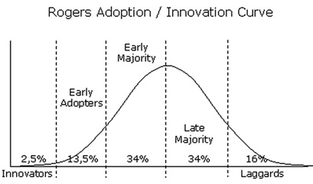
Change
Sometimes user driven
Interest in new areas, technologies
Growth
Sometimes IT driven
Software life cycles, upgrades, consolidations
Unified Communication
We interact with all levels of adoption at all times.

Slide 36
Be the enabler

Slide 37
Embrace that we are change agents.
Be the enabler, not the provider.
Celebrate your small wins. Or go crazy.
But then get back on your horse and tackle more change.

Slide 38
Family Tech Support
Or,
Why I’m a great IT professional but I’m scared to help my mom with her computer
http://www.nerdmeritbadges.com/

Slide 39
Efficiencies of IT
We’ve seen that issue before.
Or we know how to Google it…
And interpret the response.
We work with our systems.
Our AD, GPOs, anti-virus, endpoint management
Our verified hardware
Consistency, known outcomes
Our baseline is probably different than home support

Slide 40
Similar to be BYO device challenges:
Build really great institutional IT, and also provide really great support for whatever device comes along.
BYO and institution co-exist and compete.
Sorry, Mom.

Slide 41
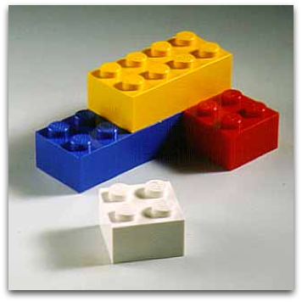
What makes you a good IT professional
Technology expertise
Computer and network wizardry
Software installation and configuration experience
Printers and mobile devices
Troubleshooting skills
(CompTIA A+ certification)
More generally, know the pieces and how they fit together

Slide 42
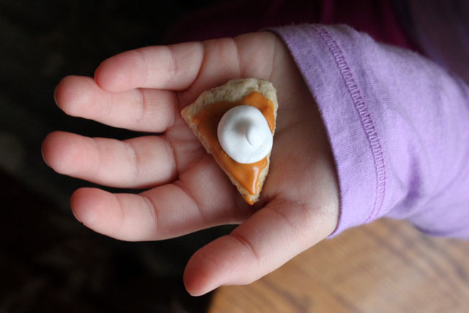
What makes you a good IT professional
Technology knowledge is a foregone conclusion.
If you don’t know it, I expect you to learn it.
PRO TIP: Being successful in IT has very little to do with technology.
http://cozywalls.com/2012/11/04/pocket-sized-pie-cookies/

Slide 43
What makes you a good IT professional
Problem Solving
Logical, detail oriented approach
Tenacity
Drive to figure out why something (doesn’t) work
Customer Service
Really wanting to understand and help the “valued partner”
Having compassion and empathy
Saying no when you really need to say no

Slide 44
What makes you a good IT professional
Stewardship
Your choices impact others.
“First do no harm.”
Ethical behavior
Understanding trends
Seeing small details and big pictures at the same time.
Find patterns of behavior/responses.
Works independently & well with others
Especially with different levels of experience/rank
Seeks help without pride or shame.

Slide 45
What makes you a good IT professional
Always improving
Doesn’t get complacent.
Always learning, challenging themselves, dreaming.
Doesn’t get bored.
An agent of change who enables others
to change their behavior or workflows
to understand the costs of those changes
to see the benefit of those changes
“What you're supposed to do when you don't like a thing is change it.
If you can't change it, change the way you think about it. Don't complain.” - Maya Angelou

Slide 46
Systematic thinker
Stewardship
Thirst for understanding
Compassion & understanding at all levels
Tenacious Learner
Customer Service
Humble Communicator
Technology

Slide 47
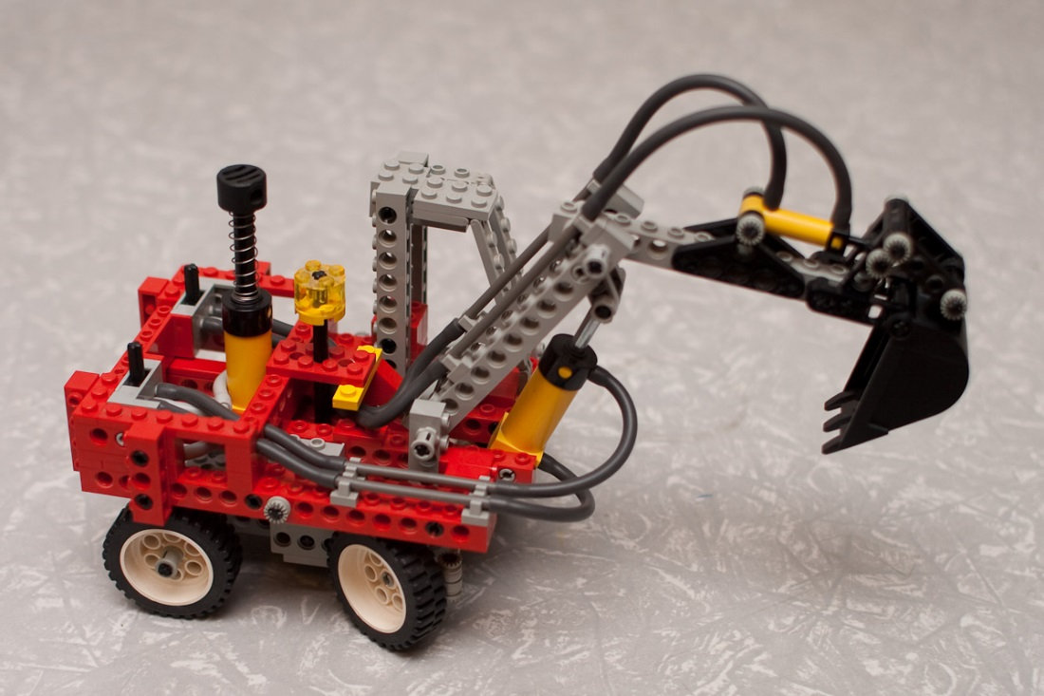
Sidebar on technologies
Technologies change anyway
IT pros have to re-invent themselves every couple of years
New tech
Keeps us from getting bored
Drives new opportunities
The U isn’t static
Regrowth is the desired skill… More than tech

Slide 48
Being successful in IT has very little to do with technology.
And the things that make you good aren’t taught.
Find your weaknesses, seek them out, and attack them to “level up” as an IT pro.

Slide 49
IT is invisible.
What do we chose to make visible?
What gets chosen for us?

Slide 50
How the users see us?
CITES
All of us

Slide 51
Asked about our lab consultants
Polled Engineering students about their perception of the student lab consultants in our EWS labs.
Results were overwhelmingly negative, seemed wasteful, didn’t get value from them, etc.
Asked what users cared about the most in the labs.
Printing.
Cleanliness.
Making sure the labs functioned properly.

Slide 52
Consider the user perspective
Their terminology, their understanding, their needs
“What does it do for me?”
The Web Is Action
What goal are they trying to achieve?
Are you helping or hurting them to reach that goal?
How do you know if you’ve been successful or not?

Slide 54
XKCD on University Websites
People go to the website because they can't wait for the next alumni magazine, right? What do you mean, you want a campus map? One of our students made one as a CS class project back in '01! You can click to zoom and everything!
http://xkcd.com/773/

Slide 55
Which one’s the Nortel VPN? The SSL VPN?
I thought Cisco was the bad VPN client?
See also: almost any IT announcement from AITS

Slide 56
Marketing IT?
Make the important things we do visible to the users
Wireless improvements
EWS server migration
Weeks of prep time, layers of communications
Day of: 8 hours of setup, migration, verification, auditing
Users saw nothing.
Is that win?
Trending: Case studies of campuses switching LMS’s

Slide 57
What gets made visible for us?

Slide 58
The SSL vulnerabilities nightmare
Many SSL problems in the last 6 months
Users not understanding what’s going on
And getting most of their news/instructions from Lifehacker
Users unclear on what to do to fix it, and when
Change your password, but not yet!
Lots of unfortunate FUD around heartbleed.

Slide 59
Think about everything that you do from your customer’s perspective.
Test your content, workflows, usage through small groups. Observe it if helps or hurts them.
Proactively market IT to our customers.

Slide 60
That’s it, folks!
Questions?
No time for questions– chat me up today or email me if you have questions. Thanks!

